Slide 1
Smart Buy
Buy everything you need in a smart way

Slide 2
Team member
Supervisor: Mr. Kiều Trọng Khánh
Đoàn Hồ Anh Triết
Đặng Hữu Hoàng
Trần Trung Dũng
Huỳnh Thanh Việt (Dropped out)

Slide 3
Outline
Scenario problem
Our solution
Demonstration
Advantages and disadvantages of current solution
Questions and answers

Slide 4
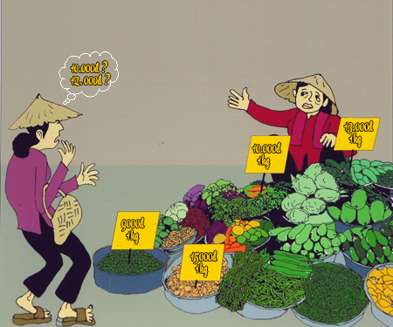
Scenario Problem

Slide 5
Scenario Problem

Slide 6
Our Ideas
Collect all data -> Structure -> User

Slide 7



Our Solution
Track
Give
System
Price
Suggestion

Slide 8
Story

Slide 9
Story Board
User/Member
Staff

Slide 10


Slide 11



Demo Scenario - Guest
Search Product
Add to cart.
View cart

Slide 12


Demo Scenario - Member
Define Routes
Ask for suggestion

Slide 13
Mobile Member

Slide 14
Data Source
Excel files.
Data mining from websites.

Slide 15
Excel Flow

Slide 16
Excel Flow
Step 1:
Step 2:
Step 3:

Slide 17
Terminology
Correct
Error.
Duplicate.

Slide 18




Demo Scenario - Staff
Import data
Train machine
Manage parsers

Slide 19
Save data to Database

Slide 20
Data mining from websites

Slide 21





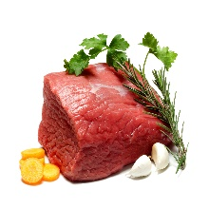










Smart Buy System
1.1
1.4
Guest
1.2
1.3
2.3
2.6
2.4
2.2
2.5
2.1
Member

Slide 22



Slide 23
Future Plan

Slide 24
THANK YOU FOR YOUR ATTENTION! Q & A

